Slide 1

Sprints
Sprint building and practice

Slide 2

Sprint Planning starts with Project Planning
So we Planned our project and came up with Tasks for the Product backlog but what about Goals?
Estimation is hard. Scrum is liked because it is simple
2-week sprint -> month check-in/release -> repeat until project done
Sprint length never changes after initial determination by project owner
Crystal length varies and can be adjusted (but a default length is determined at the beginning by project owner)
We’ll complete half a micro-sprint today and the rest on Wednesday

Slide 3
Universal Sprint planning questions – 1 hour for every week of sprint (so 3 wks = 3 hours max)
Determine the Sprint Goal
Why is this sprint valuable?
What tasks are part of this Goal?
From product backlog we make a Sprint Backlog
What can be done this sprint?
Experienced Devs can look at the product backlog and estimate timeframes and value of tasks.
Using this one can sort and determine calendar time
1 day = 8 hours
Ends with Tasks being assigned

Slide 4

Sprints – Let’s Plan a Sprint (Goal and Timeframes) together
Then you plan (or review) your sprint planning together for your own project

Slide 5



Estimation Techniques (not comprehensive)
It’s a Goldilocks Thing
By Priority or Other
Grouping similar items by area of expertise required, parts of the system, effort, or other criteria
Dot Voting
Team members are given 5 dots and vote on their top priorities (for technical reasons or business)
Ordering Protocol
Groups organize tasks from least to highest priority. Then take turns reorganizing until agreed upon.
Affinity Mapping
Timeframe
These are two types where people organize tasks into T-shirt sizes or using an uncertain in less known cases.
Bucket system
A set of buckets (with numeric values) are setup and stakeholders place tasks in bucket where they think it goes then repeat until agreement
Planning Poker
Take item, discuss briefly, show card with estimate. Agreed, add to “Deck” – disagree: discuss and revote.
T-shirt sizing / Big, Uncertain, Small

Slide 6
Sprint Planning in real-life
We typically use 3-week sprints but with one mobile medical app was a new concept and only had high-level requirements.
So we implemented the ideas in 2-week sprints, which allowed for changing and tweaking requirements from sprint to sprint. The opportunity for frequent feedback was instrumental in determining the final shape of the product.
We really were working in a combined development/prototyping mode rather than in pure product development fashion because process was not addressed until the dust had settled on requirements.

Slide 7

Sprint Planning in real-life (in order):
The client pre-determines Sprints (period)
Automation tools provide similar timeframes based on earlier projects (Yay Math!).
Experts provide estimations (using same techniques) based on experience.
This is not always Senior Devs. I haven’t built a frontend website or mobile app in a bit, so I’d defer to a junior peer who has.
Dev Team determines timeframes as a whole

Slide 8
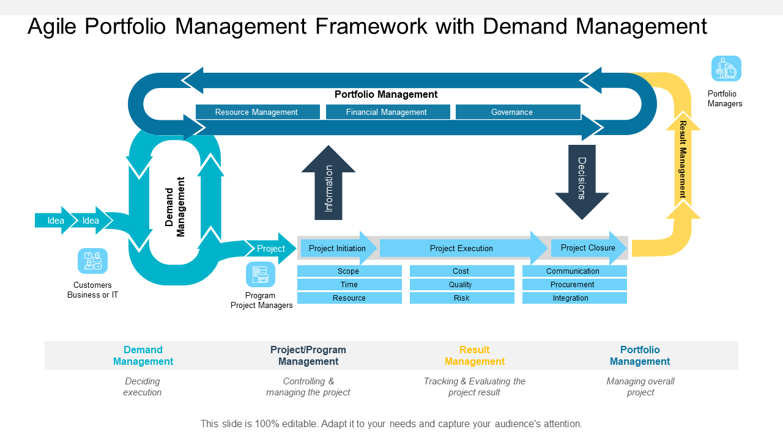
Big Projects: make a Portfolio then split into small projects
Once all items in the Portfolio are done = Big Project Done
Requires both individual project Teams (with standard Agile) and a (small) team tracking the whole portfolio
They handle Portfolio and Demand Management
Make a Portfolio Backlog: which is used to make a project backlog which is used to make sprint backlogs
Idea is Dev Teams just have normal Sprints
It’s Abstraction!

Slide 9
So let’s complete a bit of our Sprint
Ensure you can login to Github
Wednesday we will perform a few edits and/or pull and push a repository together and see how that fits within the Sprint
using retrospective & Sprint Review

